Slide 1

Starbucks Drink Nutrition
Mythri Partha

Slide 2
The Problem/Questions
Are Starbucks drinks really that calorie heavy?
Do caffeinated drinks have more calories than non-caffeinated ones? What about Iced/blended iced vs hot drinks?
Which drinks are the “healthiest” based on calories?

Slide 3

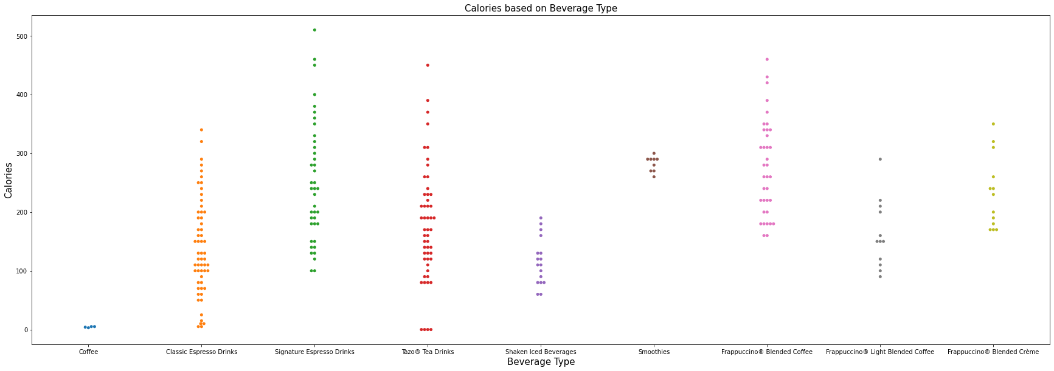
Trends I saw
When observing the models, I saw that the beverages that had the most calories were, understandably the Frappuccinos (blended beverages) and the Signature Espresso drinks
Iced beverages, however, do not have as much as frappucinos, and there are lighter frap options for those who are watching their caloric intake

Slide 4

Caffeine and Calories?
When comparing the caffeine content and the calories of drinks, more caffeine did not necessarily make the drink higher calorie as seen in this figure below, in fact, the drink with the highest caffeine content was one of the lowest in terms of calories

Slide 5
Conclusion
Overall, it seems like the best way to consume less calorie filled drinks at Starbucks is to opt for drinks that are less sugary, caffeine does not seem to be a contributing factor in high calorie drinks

